Slide 1
DHP Design

Slide 2
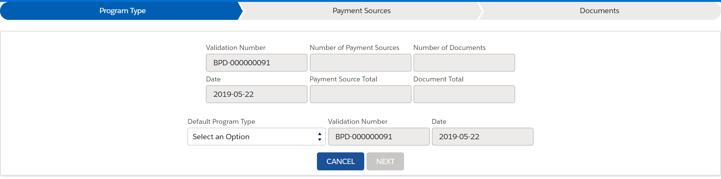
Payment of a DHP
Add a “DHP” checkbox on first tab of the Customer Envelope “wizard” (Program Type)
DHP

Slide 3
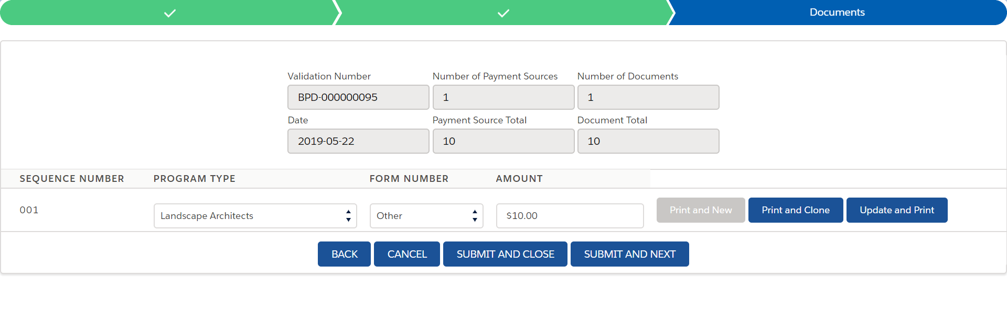
Payment of a DHP
Auto-populate “DHP” as the form number
DHP

Slide 4
Payment of a DHP - Logic
If DHP = TRUE, then create a separate queue (list view)
This will be our DHP queue

Slide 5
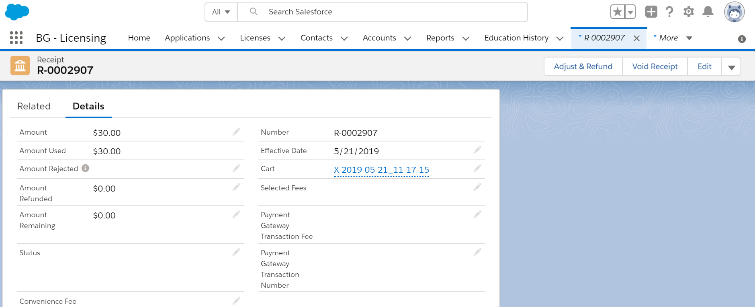
Add a lightning button “Capture DHP”

Slide 6
“Capture DHP” form
Please create the below fields as needed.
1) Enter the following on the model pop-up:
Checkbox "DHP?"
Inactivate License Date (select date via a calendar pop-up; default date is today but this is an optional field)
Override $25 handling fee (checkbox) (explanation: by default, we will create a $25 handling fee for DHP; but this gives the user an option to override that)

Slide 7
Capture DHP logic
Upon hitting save, we trigger the following:
Logic: All the licenses that were paid with that receipt record now get a DHP sub-status created on them (receipt --> fees --> 'related to' licenses
If the inactivate license date is today, then inactivate all the license records associated
If there is a delay (ex. 30 days) then we have to inactive the license records if it has been sitting DHP status for 30 days
Have a list of associated licenses on the model pop-up and have them check if they want that license to be deactivated
Create a $25 handling fee against a (any) license record associated with the receipt record (unless there is an override by the user in the modal pop-up).
Generate a letter PDF on the same license as we created the handling fee on.
(the letter configuration will be done onshore - Chris Williams)
The reversal of the fee payment record and transfer the fee into accounts receivable (the account receivable part will be configured by BasicGov)
Create item records/JV records to capture the reversal of payment, transferring the fee to AR, and the creation of the new handling fee

Slide 8
Outstanding questions
Martin – how to apply a deposit record to a fee
Martin – how do we reverse a payment that has already been made and send the fee to AR (with respect to DHP)
Danny – notify that we are using a DHP checkbox on the license record
This would put the license in inactive status
Answer
When receipt is rejected, we create NSF fee
When you void a receipt, it reverses a fee
When user opens license #1, they see payment history and they see its rejected. You create a fee and type it into the description.
On license #5, related payment, click the receipt record
Receipt related list

